Slide 1
COMP 4290
Week 9 - Wednesday

Slide 2
Last time
Mandatory access control
Bell-La Padula
Chinese Wall
Biba
Rootkits

Slide 3
Questions?

Slide 4
Project 2

Slide 5
Austin Rheyne Presents

Slide 6
Network Basics

Slide 7
Packet switched
The Internet is a packet switched system
This means that individual pieces of data (called packets) are sent on the network
Each packet knows where it is going
A collection of packets going from point A to point B might not all travel the same route
C
1
B
A
2
D

Slide 8
Circuit switched
Phone lines are circuit switched
This means that a specific circuit is set up for a specific communication
Operators used to do this by hand
Now it is done automatically
Only one path for data
A
C
B
1

Slide 9
Circuit vs. packet switching
Which one is faster?
Circuit switching
Which one is more predictable?
Circuit switching
So, why is the Internet packet switched?
More adaptable

Slide 10
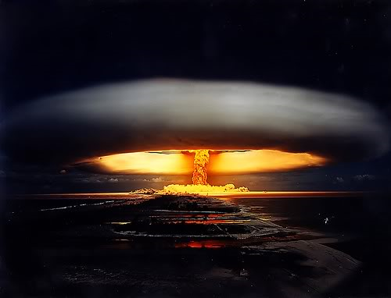
ARPA
The Advanced Research Projects Agency was created in 1958 to respond to the Russians launching Sputnik
The ARPANET connected its first two major nodes over 10 years later
Packet switched was used so that the network could still communicate after a nuclear strike

Slide 11
Network strength
If a single cut can case a network to go down, that network is vulnerable to a single point of failure
Most important networks like electrical systems have redundancy so that this doesn't happen to a whole city
Resilience or fault tolerance

Slide 12
Terminology
A computer network is at least two computers connected together
Often one is a server and the other is a client
A computer system in a network is called a node
The processor in a node is called a host
A connection between two hosts is a link

Slide 13
Network characteristics
Anonymity: We don't know who we're dealing with
Automation: Communication may be entirely between machines without human supervision
Distance: Communications are not significantly impacted by distance
Opaqueness: It is hard to tell how far away other users are and to be sure that someone claiming to be the same user as before is

Slide 14
Shape and size
The arrangement of a network, in terms of its links, is called its topology
The boundary separates systems that are on a network from those that are not
With the Internet, this line is blurry
It is hard to know who owns hosts in a network
Makes enforcing the law difficult
How is a network controlled? Who does it?

Slide 15
Communication
Analog or digital
A modem converts between the two
Portmanteau of "modulator-demodulator"
Copper wire is the main workhorse
Twisted pair is a pair of insulated copper wires
Limit of about 10 Mbps and about 300 feet without a boost
Coaxial cable has a single wire surrounded by an insulation jacket covered by a grounded braid of wire
Repeaters or amplifiers are needed periodically to prevent signal degradation

Slide 16
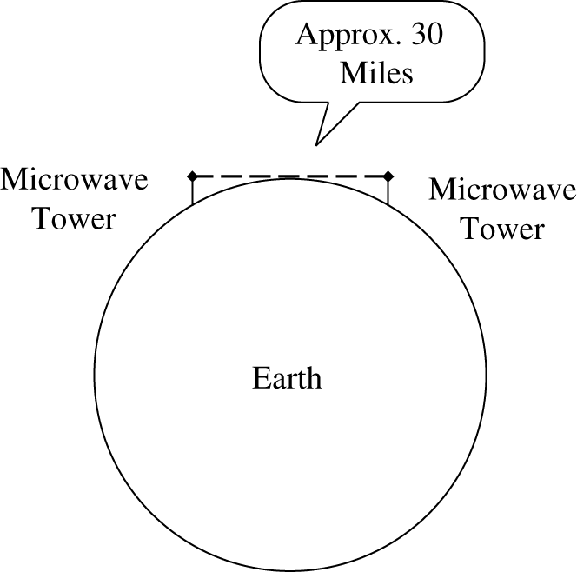
Other media
Optical fiber
Carries light instead of electricity
Higher bandwidth and less signal degradation than copper
Replacing aging copper lines
Wireless
Good for short distance
Uses radio signals
Microwave
Strong signals
Requires line of sight
Infrared
Similar to microwave but weaker signals
Satellites
Need geosynchronous orbits
Secure applications need smaller footprints than broadcasts

Slide 17
Protocols
Application
Transport
Physical
Presentation
Session
Network
Data Link
There are many different communication protocols
The OSI reference model is an idealized model of how different parts of communication can be abstracted into 7 layers
Imagine that each layer is talking to another parallel layer called a peer on another computer
Only the physical layer is a real connection between the two

Slide 18
Layers
Protocols and standards define each layer
Not every layer is always used
Sometimes user errors are referred to as Layer 8 problems
Layer | Name | Activity | Example
7 | Application | User-level data | HTTP
6 | Presentation | Data appearance, some encryption | TLS
5 | Session | Sessions, sequencing, recovery | IPC and part of TCP
4 | Transport | Flow control, end-to-end error detection | TCP
3 | Network | Routing, blocking into packets | IP
2 | Data Link | Data delivery, packets into frames, transmission error recovery | Ethernet
1 | Physical | Physical communication, bit transmission | Electrons in copper

Slide 19
TCP/IP
The OSI model is conceptual
Most network communication uses TCP/IP
We can view TCP/IP as four layers:
Layer | Action | Responsibilities | Protocol
Application | Prepare messages | User interaction | HTTP, FTP, etc.
Transport | Convert messages to packets | Sequencing, reliability, error correction | TCP or UDP
Internet | Convert packets to datagrams | Flow control, routing | IP
Physical | Transmit datagrams as bits | Data communication

Slide 20
TCP/IP
Transmission Control Protocol (TCP)
Creates a reliable communication session
Wraps information into packets
Uses port numbers to connect processes to information streams
User Datagram Protocol (UDP)
Alternative to TCP that is unreliable but has low overhead
Internet Protocol (IP)
Allows for unreliable transport
Wraps packets into datagrams
Uses IP addresses for routing

Slide 21
Addressing
A message datagram is sent to a domain name such as google.com
The Domain Name System (DNS) converts google.com into an IP address such as 74.125.226.229
The server at 74.125.226.229 receives the datagram and unwraps the corresponding packet
The packet has a port number (probably port 443, for HTTPS), which is delivered to whatever program is communicating on port 443

Slide 22
Types of Networks
Local area network (LAN)
Small: Often not more than 100 users within 2 miles
Local controlled
Physically protected
Limited scope
Wide area network (WAN)
One organization controls it
Covers a large distance
Physically exposed
Internetworks
A connection of two or more separate networks
The most significant is the Internet
Enormous
Heterogeneous
Physically and logically exposed

Slide 23
Network Threats

Slide 24
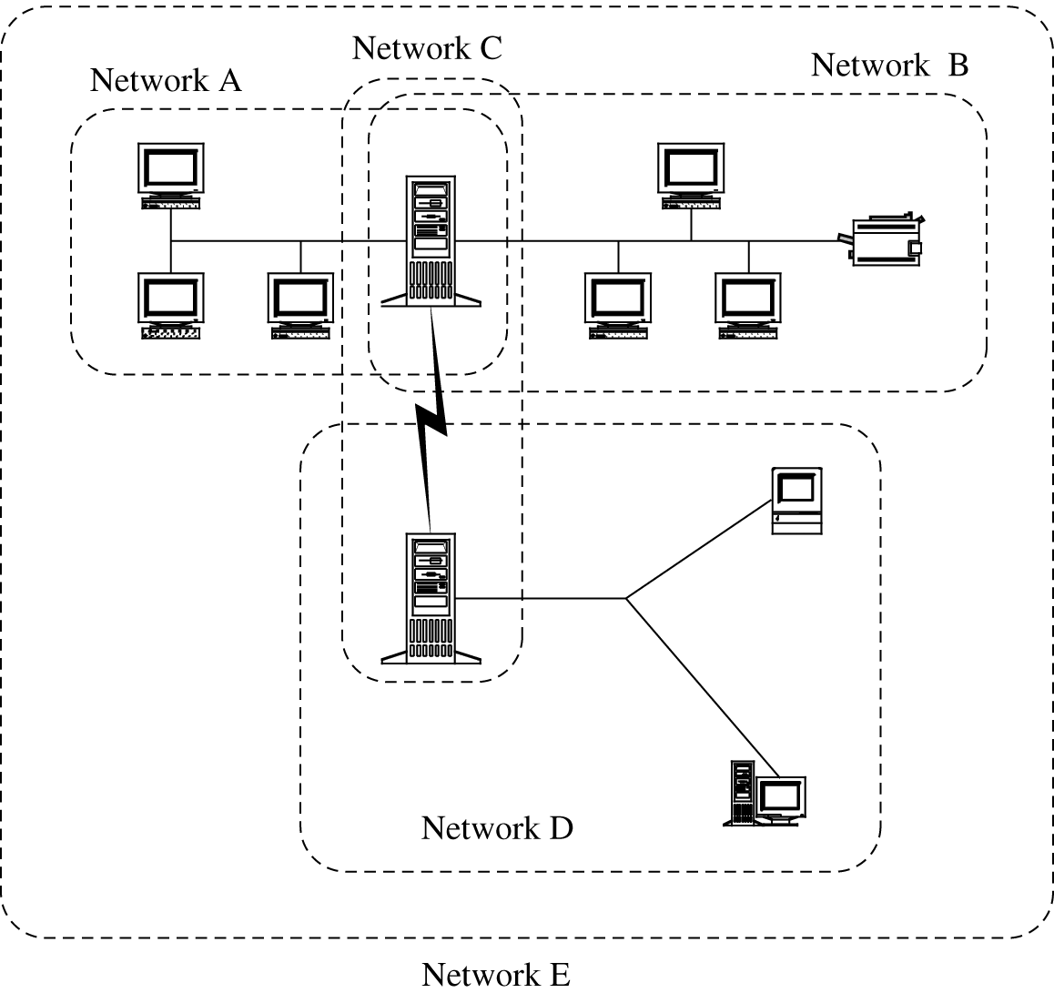
Why is a network vulnerable?
Anonymity
Many points of attack (targets and origins)
Sharing
Complexity
Unknown perimeter

Slide 25
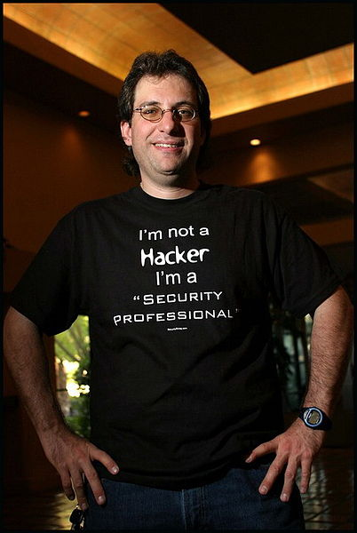
Why do people attack networks?
Kevin Mitnick
Once the most wanted computer criminal in the US
Challenge
Fame
Money
State espionage
Industrial espionage
Organized crime
Stolen credit card numbers
Identity theft
Ideology
Hacktivist groups like Anonymous
Cyberterrorism
Used to be from groups like al Qaeda
Now more commonly from quasi-government-affiliated groups like Pakistani Cyber Army or Syrian Electronic Army

Slide 26
Mid-Semester Evaluation

Slide 27
Upcoming

Slide 28
Next time…
Network security controls
Firewalls
Intrusion detection
Network management
Austin Rheyne presents

Slide 29
Reminders
Read Sections 6.6 through 6.9
Keep working on Project 2
Due this Friday

